Slide 1
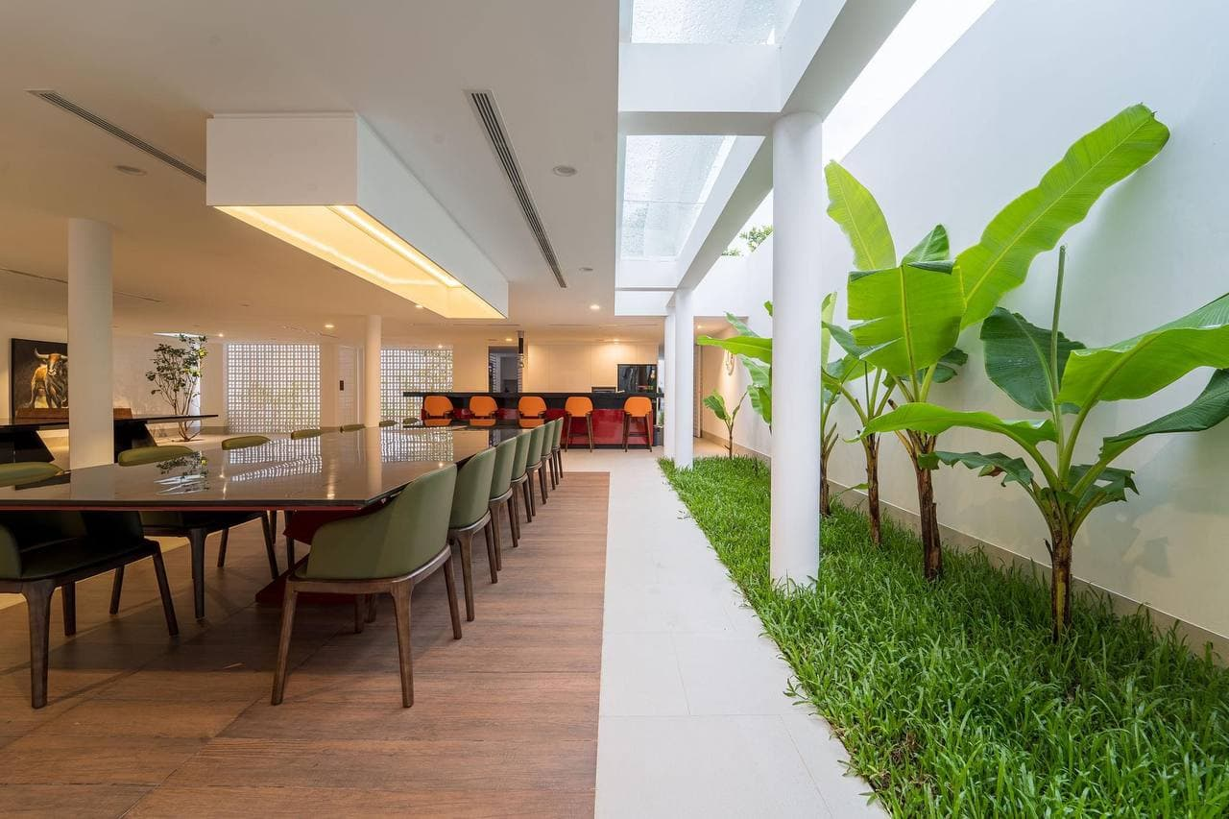

ENGINEERING
PROJECT
PROPOSAL
Holiday Home in Cambodia
Here is where your presentation begins
Lecturers:
Mr. TAL Tongsreng (Course)
Mr. CHAN Sophal (TP)

Slide 2
GROUP 3
MAO Kimlang (e20201055)
KEO Vonmonyroth (e20200759)
HIN Bunra (e20201287)
HAK Kimhong (e20200242)
CHEA Makara (e20201131)

Slide 3
ABOUT THE PROJECT
01
OBJECTIVE
02
TABLE OF CONTENTS
PROGRESS OF THE PROJECT
03
TYPES OF DATA COLLECTION
04

Slide 4
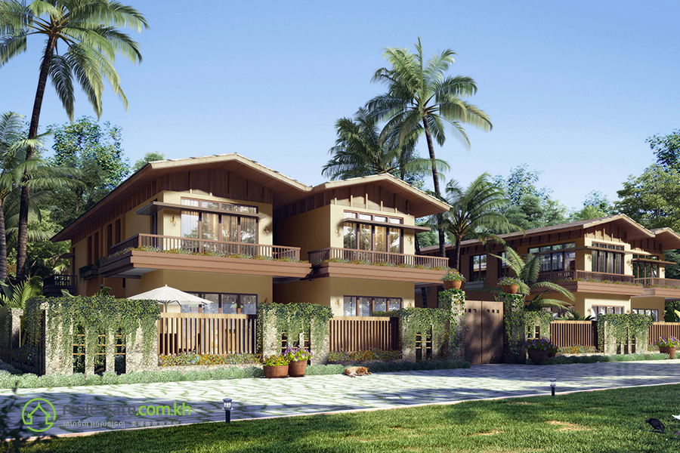
ABOUT THE PROJECT
Holiday home is a kind of home that is another property of a family or that family own in order to holiday or their vacation whatever when they want to relax or release their stress with the natural places, by the sea, by the river or tourist areas, etc. Moreover, holiday home is the best place for awaited break from a busy life and give our mind and body some rest form everyday life such as people need to relaxion time after their working for along month.

Slide 5
2.
2. OBJECTIVE
By observation, in Cambodia there are not many programs or website yet. After all, we’re going to try to create a website or program that is easy to find holiday home like in some province in Cambodia. Not only make it easier but also it can get income for sure.

Slide 6
3. PROGRESS OF THE PROJECT
Makara (Collect data)
Bunra ( HTML & CSS)
Monyroth (Connect to database)
Kimhong ( HTML & CSS)
Mercury is the closest planet to the Sun and the smallest one in the Solar System—it’s only a bit larger than our Moon. The planet’s name has nothing to do with the liquid metal, since it was named after the Roman messenger god, Mercury
Problem :
Collect data (mostly home have only for rent)
HTML
Connect to database

Slide 7
4. DATA COLLECTION
Type of home | Land Size | Building Size | Room | Location | Derection | Selling price/ rent | Specifi
Home | 16m x 25m | 8m x 14m | Bed:2 , Bath: 3, Living:1, Kit:1 | Presehanuk | South | 100,000$ | Sea & Mountain
Mercury is the closest planet to the Sun and the smallest one in the Solar System—it’s only a bit larger than our Moon. The planet’s name has nothing to do with the liquid metal, since it was named after the Roman messenger god, Mercury

Slide 8
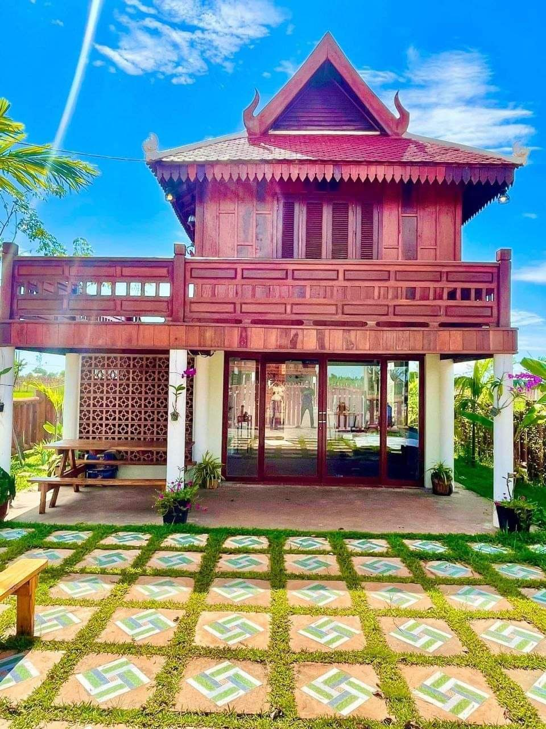

THANKS
Does anyone have any questions?
Follow the project updates

